Slide 1


Slide 2
Agenda
Problem Statement 03
Data Mining - 01 04
Data Mining - 02 05
Exploratory Data Analysis (EDA) 06
Data Visualization 07
Algorithms Used 08
Analysis of Results 09
Conclusion & Future Work 10

Slide 3
Problem Statement
Fraud detection is a challenging task that requires advanced techniques to identify and prevent fraudulent transactions. However, most existing fraud detection methods rely on predefined rules or thresholds that are not adaptive to changing patterns of fraud. How can we develop a data-driven approach that can learn from historical data and detect fraud in real time?

Slide 4
Data Mining - 01
Only int ,float , object types are found in data set
Object data types are converted into int using LabelEncoder
No null values are present in data set
Duplicate values are not found in data set

Slide 5
Data Mining - 02
Target variable ----- is_fraud
Independent variables include (step,type, amount,nameOrig,oldbalanceOrg,newbalanceOrig,nameDest, oldbalanceDest,newbalanceDest,isFlaggedFraud,isFraud_A,isFraud_P)

Slide 6
Exploratory Data Analysis (EDA)
Import Requried Libraries
Spliting the data
x_train,x_test
y_train,y_test
Scaling the features by using minmax scaler
Build the algorithm

Slide 7
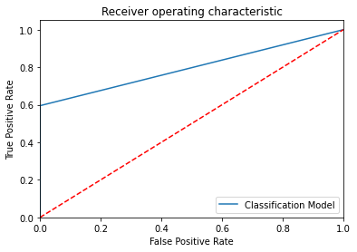
Data Visualization

Slide 8
Algorithms Used
Linear Regression
Decision Tree Regressor
Random Forest Regressor
Extra Tree Regressor
Naive Bayes Model
KNN Regressor
SVR

Slide 9
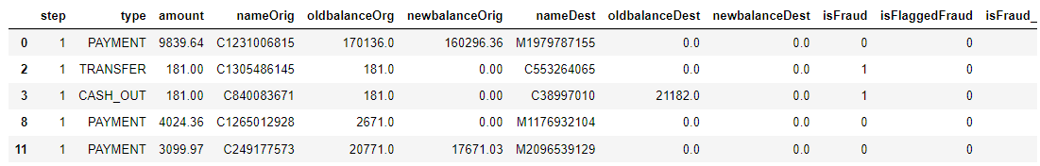
Analysis of Results

Slide 10
Conclusion and Future Work
CONCLUSION
In this study, we used data mining and machine learning techniques to identify fraud patterns, anomalies, and outliers in large and complex data sets. We applied various methods, such as clustering, association rule mining, outlier detection, and anomaly detection, to different domains and scenarios, such as health care fraud, insurance fraud, credit card fraud, and tax evasion. We showed that our methods can discover hidden and novel fraud schemes, as well as provide actionable recommendations for fraud prevention and mitigation.
FUTURE WORK
Enhancing the interpretability and explainability of the fraud detection models and outputs, such as by using attention mechanisms, visualization techniques, or natural language generation, to provide more transparent and trustworthy results and recommendations for fraud prevention and mitigation. Advancing real-time forecasting capabilities to support businesses in making immediate decisions and responding rapidly to emerging trends and market shifts

Slide 11
Thank You
Q & A
Student Name : Manthena Sanjay
Roll Number:21B91A05I9
SRKR Engineering College
Mobile: +91 8885545965
Email: 21B91A05I9@srkrec.ac.in
Bhimavaram - India

